Slide 1
Introduction to Machine Learning and Control for Building Energy Systems
Ján Drgoňa
Associate Professor @ CaSE & ROSEI

Slide 2
Course Syllabus
Week 1: Introduction to Building Energy Systems
Week 2: HVAC systems and heat transfer modeling
Week 3: Dynamical systems fundamentals
Week 4: Control systems fundamentals
Week 5: Machine learning fundamentals - with HVAC load forecasting example
Week 6: System identification - with thermal dynamics modeling example
Week 7: Constrained optimization fundamentals
Week 8: Optimal control fundamentals
Week 9: Model predictive control of building energy systems
Week 10: Practical implementation aspects and high-fidelity building emulators
Week 11: Project evaluation with presentations

Slide 3
Grading and Course Expectations
Participation 10%
Homework 30% - week 3-5
Project proposal 10% - week 6
Project progress report 10% - week 8
Project final report 20% - week 10
Project presentation 20% - week 11

Slide 4
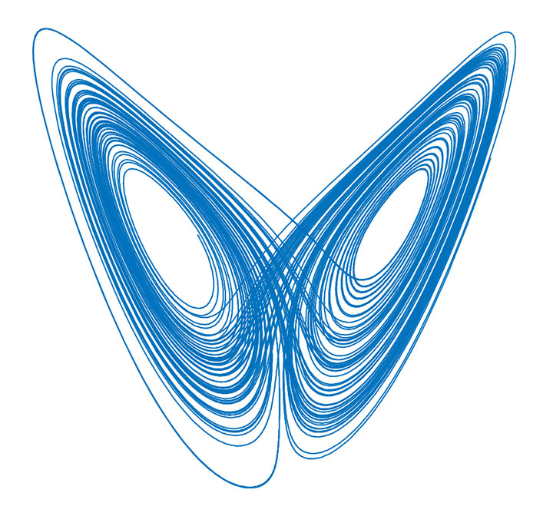
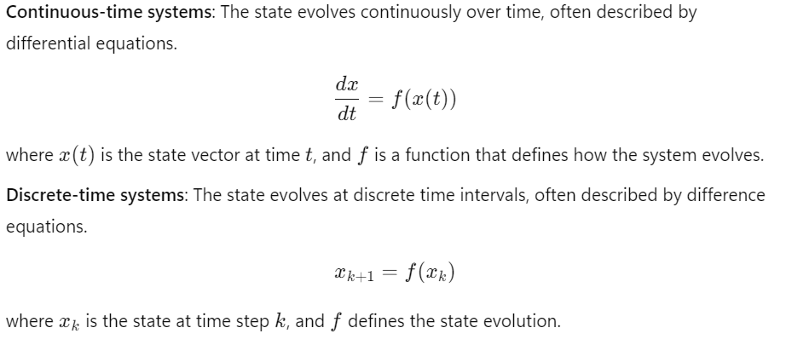
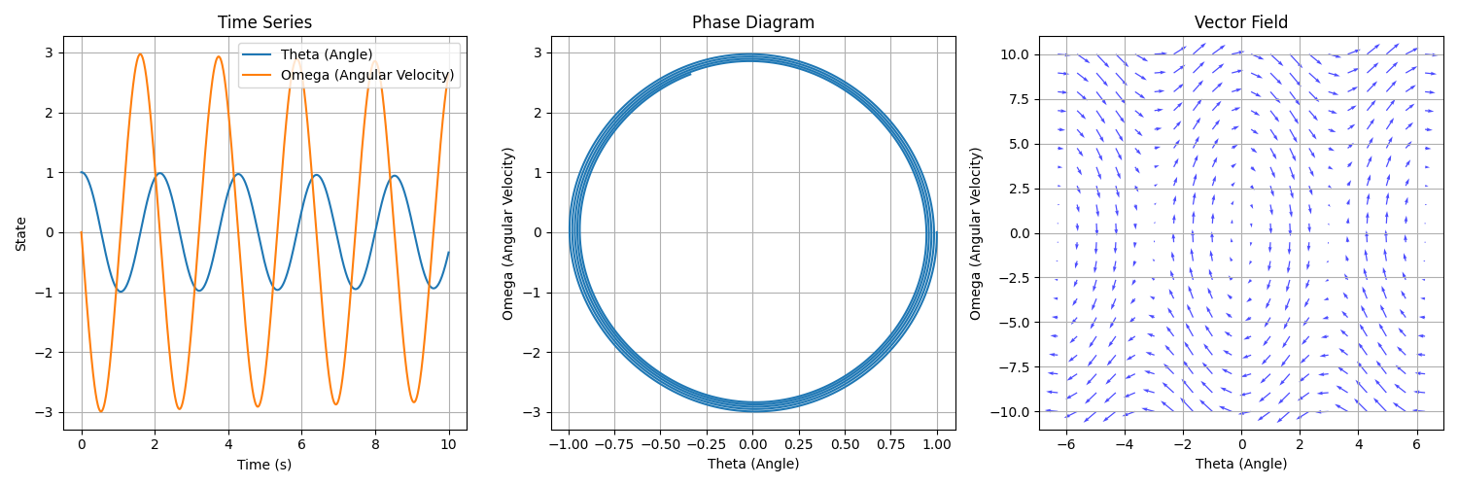
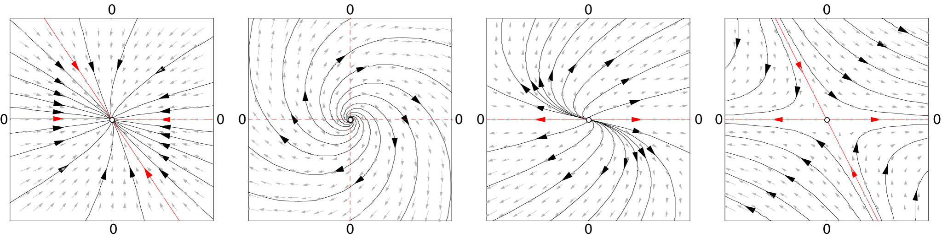
Week 4: Dynamical Systems Fundamentals
Phase space diagrams
Stability analysis
Time series
Vector fields

Slide 5
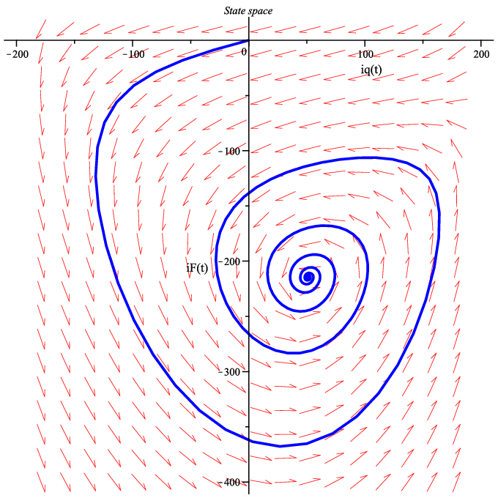
Dynamical Systems Jargon
State space: the set of all possible states the system can be in.
Dynamics rule/map: describes how the system evolves over time. Either described by differential (continuous tine) or difference equations (discrete time).
Trajectory: the path a system follows through phase space.
Initial condition: specifies the starting state of a dynamical system at a given initial time.
Fixed point (equilibrium): a state where the system does not change.
Stable fixed point: nearby points move toward it, i.e., dynamics map is contracting.
Unstable fixed point: nearby points move away from it, i.e., dynamics map is expanding.
Example of a single trajectory with stable fixed point plotted over a vector field in 2D state space.
https://en.wikipedia.org/wiki/Dynamical_system

Slide 6
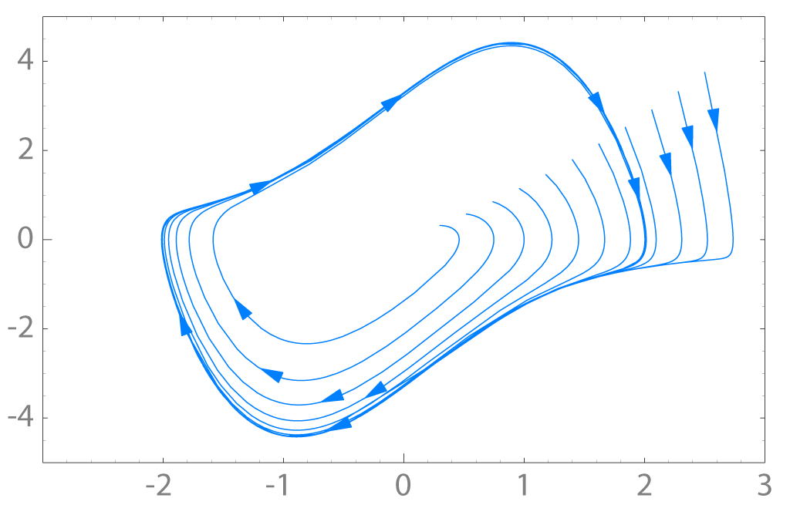
Dynamical Systems Jargon
Attractor: is a set of states toward which a dynamical system evolves over time.
Stable systems: small changes in initial conditions lead to convergent trajectories.
Unstable systems: small changes in initial conditions grow exponentially over time.
Limit cycles: closed trajectory that the system repeatedly follows.
Chaotic systems: extreme sensitivity to initial conditions, leading to vastly different outcomes.
Stable attractor
Unstable attractor
Limit cycle attractor
Chaotic attractor

Slide 7
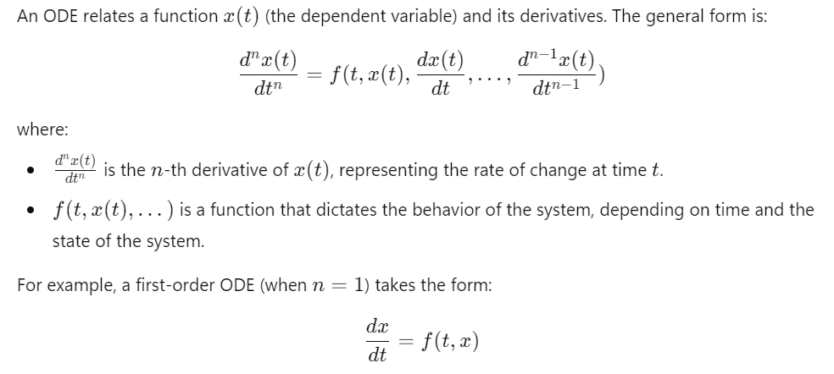
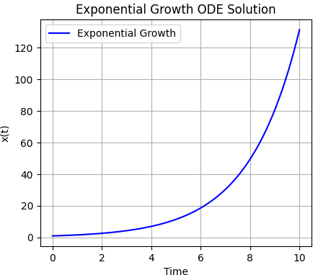
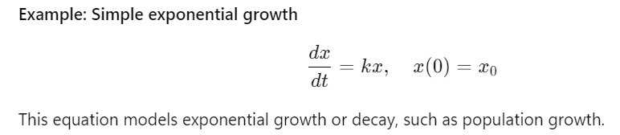
Ordinary Differential Equations (ODEs)
https://en.wikipedia.org/wiki/Ordinary_differential_equation

Slide 8
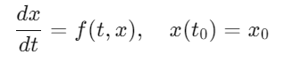
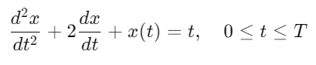
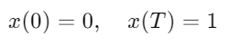
ODE Solutions
ODE Solution is a function x(t) (or set of functions) that satisfies the ODE equations.
Analytical: some ODEs can be solved exactly using algebraic methods or known techniques.
Numerical: most of the ODEs cannot be solved analytically, but they can be solved numerically by approximating the solution at discrete points in time. Example of methods:
Euler method
Runge-Kutta method
Initial Value Problem (IVP): involves solving an ODE with an initial condition that allows for determining a unique solution.
Boundary Value Problem (BVP): the solution is determined by specifying values of the solution (sometimes its derivatives) at more than one point, typically at the boundaries of the domain.

Slide 9
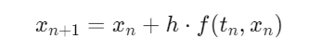
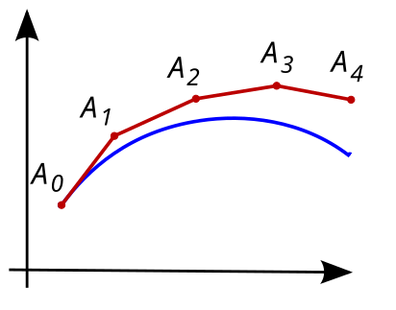
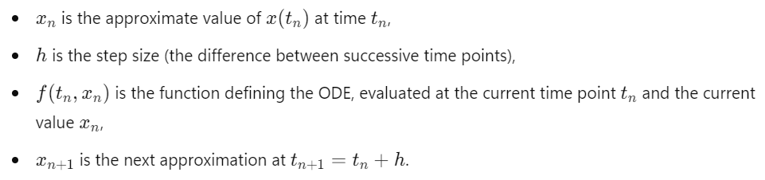
Numerical Solutions: Euler Method
The Euler method is a first-order finite difference numerical method used to approximate solutions to initial value problems (IVPs) of ordinary differential equations (ODEs).
First-order ODE IVP:
Euler method formula:
https://en.wikipedia.org/wiki/Euler_method

Slide 10
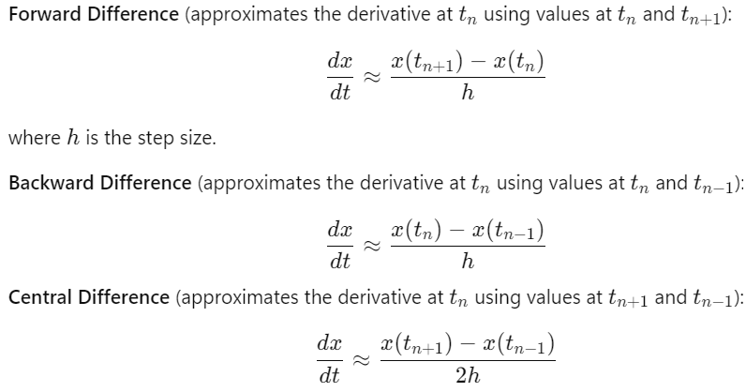
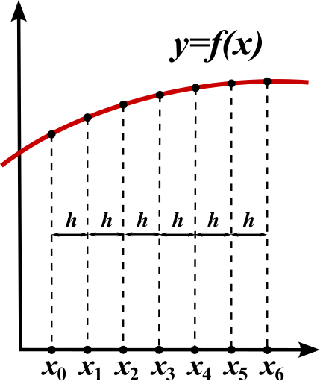
Numerical Solutions: Finite Difference Method
The Finite Difference Method (FDM) is a numerical technique used for solving differential equations. In FDM, derivatives are approximated by finite differences, which convert continuous differential equations into discrete algebraic equations that can be solved numerically. These approximations are derived by considering the behavior of a function at discrete points on a grid.
Some FDM derivative approximation schemes:
https://en.wikipedia.org/wiki/Finite_difference_method

Slide 11
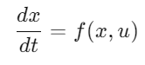
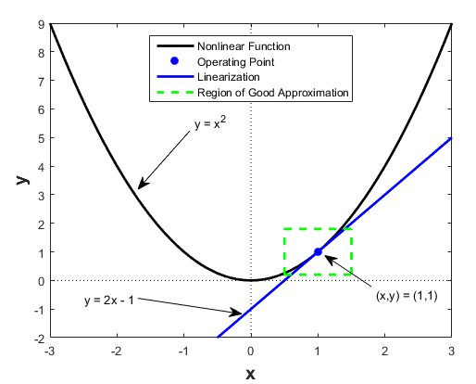
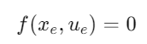
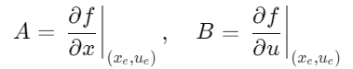
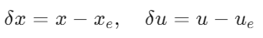
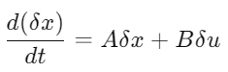
Numerical Solutions: Linearization of Nonlinear ODEs
Given nonlinear ODE with control inputs u:
Step 1: Find the Operating Point (Equilibrium):
Step 2: Compute the Jacobian Matrices:
Step 3: Form the Linearized System:
https://apmonitor.com/pdc/index.php/Main/ModelLinearization
https://www.mathworks.com/help/slcontrol/ug/linearizing-nonlinear-models.html

Slide 12
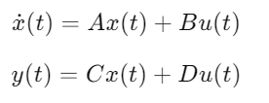
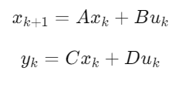
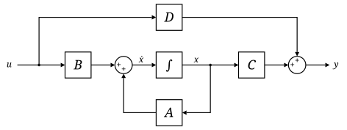
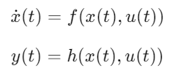
State Space Models (SSMs)
A State Space Model (SSM) is used to describe dynamic systems in a structured form of first-order differential or difference equations. SSMs are widely used in control theory.
Continuous-time linear SSM:
Discrete-time linear SSM:
Linear SSM block diagram:
Continuous-time nonlinear SSM:
https://en.wikipedia.org/wiki/State-space_representation
https://apmonitor.com/pdc/index.php/Main/StateSpaceModel

Slide 13
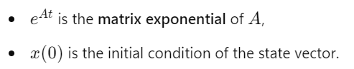
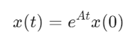
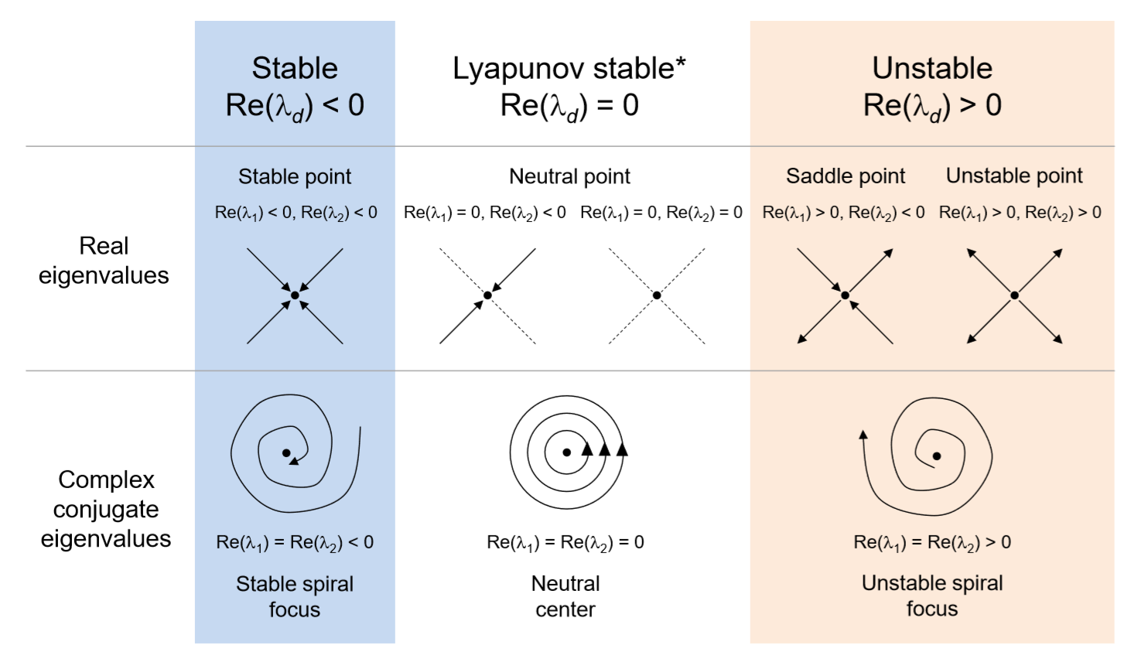
Solutions and Stability of Linear State-Space Models
Continuous-time linear SSM:
General solution to the state equation without inputs u(t):
Eigenvalues λ represent the factors by which the system's behavior is scaled when a linear transformation (represented by a matrix A) is applied to a vector (the state x).
Eigenvalues and stability:
Asymptotic stability: All eigenvalues of A have negative real parts.
Lyapunov Stable: All eigenvalues of A have non-positive real parts.
Unstable system: At least one eigenvalue of A has a positive real part.
https://en.wikipedia.org/wiki/Lyapunov_stability
https://files.mtstatic.com/

Slide 14
Homework Assignment
Using python solve IVP of a nonlinear ODE system of your choice with numerical solution method of your choice. Include time series visualizations using matplotlib. Experiment with different parameters such as timesteps, simulation time, and ODE system parameters.
Bonus: Using Jacobian matrix linearization, evaluate stability at different points in the state space.
Examples of 2D and 3D ODE systems:
Lotka-Volterra Predator-Prey Model
Spring-Mass-Damper System
Lorentz attractor
Double pendulum or Damped Pendulum
Examples of IVP solution methods:
Forward Euler
Implicit Method (Backward Euler)
Runge-Kutta
Midpoint Method (A Special Case of Runge-Kutta)

Slide 15
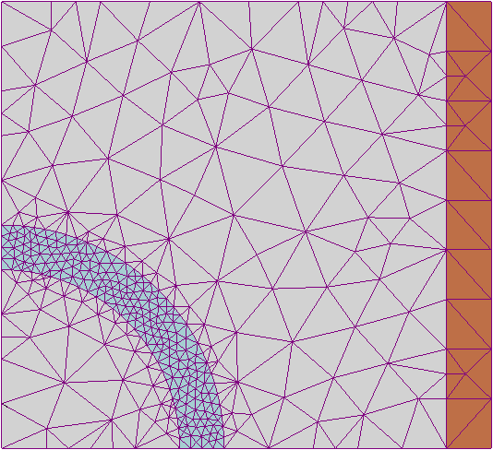
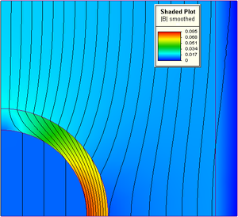
Bonus: Numerical Solutions: Finite Element Method
The Finite Element Method (FEM) is a widely used numerical technique for solving boundary value problems (BVP) and partial differential equations (PDEs). It is particularly useful for problems with complex dynamics and boundary conditions that cannot be easily solved analytically.
Basic steps in FEM:
Discretization: divide the problem domain into smaller subdomains called elements. These elements are connected at points called nodes. A mesh is formed by connecting these elements.
Choice of interpolation functions: within each element, approximate the unknown solution using polynomials or other simple functions.
Deriving Element Equations: for each element, the equations are written in a form that can be solved using the interpolation functions.
Assembly of the Global System: local element equations are assembled into a global system of equations that represents the entire problem.
Imposing Boundary Conditions: these conditions help to ensure that the solution satisfies the problem's physical constraints.
Solution of the System: The global system of equations is then solved using numerical methods.
https://en.wikipedia.org/wiki/Finite_element_method

